Slide 2
COPYRIGHT/PERMISSION TO REPRODUCE The Financial Basics workshop materials are covered by the provisions of the Copyright Act, by Canadian laws, policies, regulations and international agreements. Such provisions serve to identify the information source and, in specific instances, to prohibit reproduction of materials without written permission. COMMERCIAL REPRODUCTION Reproduction of multiple copies of Financial Basics workshop materials, in whole or in part, for the purposes of commercial redistribution is prohibited except with written permission from the Financial Consumer Agency of Canada (FCAC). To obtain permission to reproduce for commercial purposes materials created by FCAC, please contact us with your request. Mailing Address: Financial Consumer Agency of Canada 427 Laurier Avenue West, 6th Floor Ottawa ON K1R 1B9 FOR MORE INFORMATION: Please visit FCAC’s Important Notices section at www.fcac.gc.ca or visit The Crown Copyright and Licensing section at www.publications.gc.ca. FCAC Contact Information: info@fcac-acfc.gc.ca Toll-free numbers: For services in English: 1-866-461-FCAC (3222) For services in French: 1-866-461-ACFC (2232)

Slide 3
INTRODUCTION

Slide 4
INTRODUCTION
What you will learn during this workshop
How to manage your spending and prepare a realistic budget.
Ways to save.
How to manage credit.
How to pay off debt.
How to invest to make your money work for you.
How to plan to reach your own financial goal.
How to protect yourself from fraud.
3

Slide 5
INTRODUCTION
Benefits of being more financially literate
Control your financial future.
Achieve your life goals.
Provide for yourself and your family.
Be a smarter consumer.
Reduce stress and sleep better at night.
4

Slide 6
INTRODUCTION
The current average percentage of their income that Canadians save is:
a) 5%
b) 7.5%
c) 10%
5

Slide 7
INTRODUCTION
In 2010, the average household debt of Canadians was:
a) $26,000
b) $56,000
c) $96,000
6

Slide 8
http://business.financialpost.com/personal-finance/debt/household-debt-creeps-up-to-a-fresh-record-with-canadians-owing-2-trillion-by-the-end-of-2016

Slide 9
INTRODUCTION
In 2009, the total reported dollar loss by victims of identity theft in Canada was about:
$7 million
$9 million
$11 million
8

Slide 11
INTRODUCTION
In 2009, the average debt:
For college graduates was:
$3,500
$8,500
$13,500
For a university graduates was:
$11,500
$26,500
$32,500
10

Slide 12
INTRODUCTION
The percentage of Canadian youth whose parents are not expected to contribute any savings to their education after high school is:
a) 25%
b) 35%
c) 50%
11

Slide 13
BUDGETING

Slide 14
BUDGETING
Parts of a budget
Income
Expenses
Difference between the two: surplus or deficit
13

Slide 15
BUDGETING
Know what you spend
Keep every receipt.
Record every expense in a notebook or electronic device.
Review bank and credit card statements.
Do this for at least three months.
Make a list of irregular expenses (gifts, donations, car or home repairs, vacations).
Total your expenses at the end of
the month.
14

Slide 16
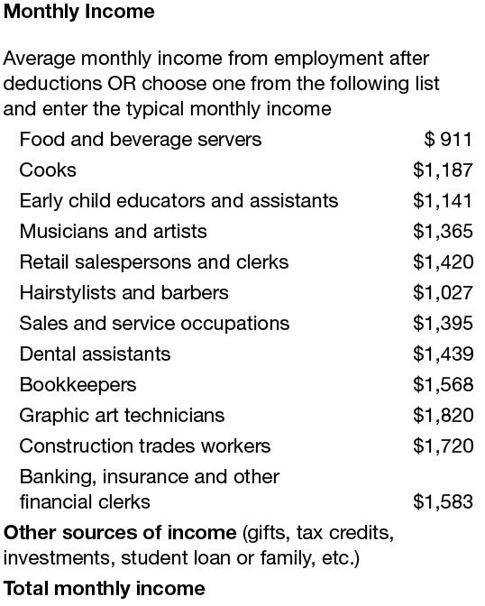
BUDGETING
Monthly income
15

Slide 17
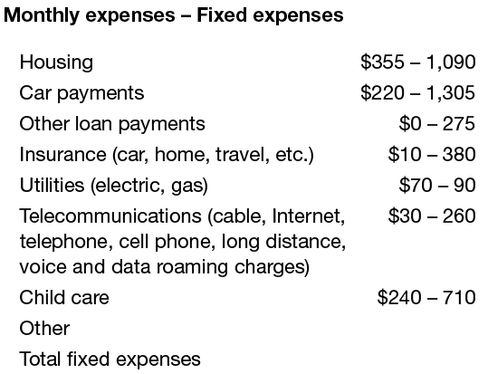
BUDGETING
Monthly expenses
Fixed vs variable expenses
16

Slide 18
BUDGETING
Net surplus or deficit
Difference between total monthly income and total monthly expenses =
Net surplus _______________
OR
Net deficit _______________
17

Slide 19
MANAGING YOUR COST OF LIVING – BE A SMART CONSUMER

Slide 20
MANAGING YOUR COST OF LIVING – BE A SMART CONSUMER
Areas for saving
Check your bills.
Negotiate better plans (banking fees and services, telephone, cell phone).
Pack a lunch.
Consider whether you need to own a car, a home or the latest high-tech gadget.
19

Slide 21
MANAGING YOUR COST OF LIVING – BE A SMART CONSUMER
Check your bills
Spot mistakes and overcharges.
Pay less in late fees, interest and penalties.
Get errors corrected before it’s too late.
20

Slide 22
MANAGING YOUR COST OF LIVING – BE A SMART CONSUMER
Negotiate better plans
Call each service provider and ask:
• How can I cut back my monthly bills?
• Am I currently on any plans?
• Do you have a better plan or deal for me?
• If so, what is the timeframe?
• Will I be put on contract for any new deals?
• Can I bundle services to save money?
• Can I avoid interest or late payment penalties?
21

Slide 23
MANAGING YOUR COST OF LIVING – BE A SMART CONSUMER
Reduce banking costs
What am I paying in monthly service charges?
How much am I paying for ATM fees?
Can I save by doing more banking online?
Am I eligible for a low-fee deal if I’m a student?
Can I get a reduced fee if I keep a minimum balance?
Can you suggest a better plan for me?
22

Slide 24
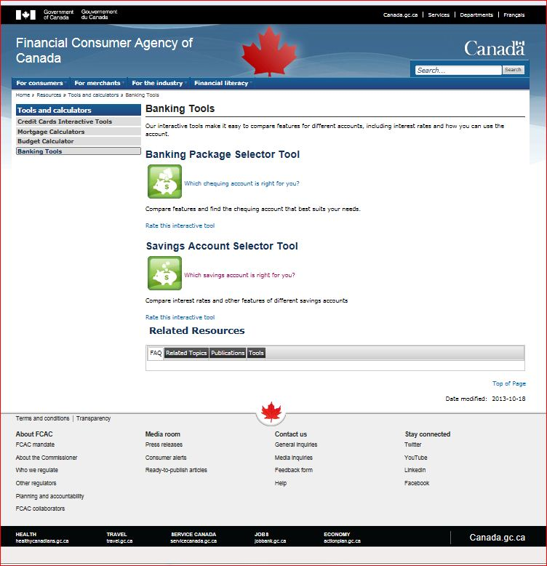
MANAGING YOUR COST OF LIVING – BE A SMART CONSUMER
Banking Tools
23

Slide 25
MANAGING YOUR COST OF LIVING – BE A SMART CONSUMER
Compare phone costs
What am I paying for land line and cell phone?
How much do my long-distance calls cost?
Can I bundle services together to save?
Can I switch suppliers to save money?
Do I have a contract? When does it expire?
Have I called suppliers to ask how to cut costs?
24

Slide 26
MANAGING YOUR COST OF LIVING – BE A SMART CONSUMER
Bundling services pays big-time
You pay $25/month for home phone, $30 for cell phone, $35 for Internet and $40 for cable TV = $130
Example of bundling discounts:
Combine 2 services, save 5%
Combine 3 services, save 10%
Combine 4 services, save 15%
Save 15% of $130 = $19.50 per month
25

Slide 27
MANAGING YOUR COST OF LIVING – BE A SMART CONSUMER
How to save on food
Eat breakfast at home.
Bring your lunch, drinks and snacks (and coffee).
“Veg out” on meatless meals once a week or more.
Cook one big dish on weekends and freeze.
Shop with a buddy at discount supermarkets and split quantities.
Set a budget and stick to it.
Bring a list and don’t shop on an empty stomach.
26

Slide 28
MANAGING YOUR COST OF LIVING – BE A SMART CONSUMER
Do you really need a car?
Add up the real costs of ownership (gas, insurance, depreciation, interest and maintenance).
Check out Driving Costs brochure
www.caa.ca, under Working for You, click Driving Costs.
Try the Vehicle Lease or Buy Calculator
www.ic.gc.ca, select Just for consumers, select Office of Consumer Affairs (OCA), click Spending Smarter Calculators.
Check out The Car Sharing Network
www.carsharing.net, click Where to find Car Sharing.
27

Slide 29
MANAGING YOUR COST OF LIVING – BE A SMART CONSUMER
When owning a home doesn’t make sense
When you move frequently:
It takes at least 5 years to make it worthwhile.
If you have a very low down payment:
You’ll need mortgage default insurance.
You may have a higher interest rate.
When your income covers only mortgage payments and taxes.
28

Slide 30
MANAGING YOUR COST OF LIVING – BE A SMART CONSUMER
Can you afford it?
Try it out:
Put the monthly costs of owning a home (mortgage, property taxes, maintenance, etc.) into a savings account.
Can you afford to live on what’s left?
Could you afford higher costs for heating, taxes or insurance?
IEF Buy or rent calculator:
www.GetSmarterAboutMoney.ca, under Tools & Calculators, click Calculators, under Home Ownership
Rent or Buy a Home Calculator
www.ic.gc.ca, select Just for consumers, select Office of Consumer Affairs (OCA), click Spending Smarter Calculators
29

Slide 31
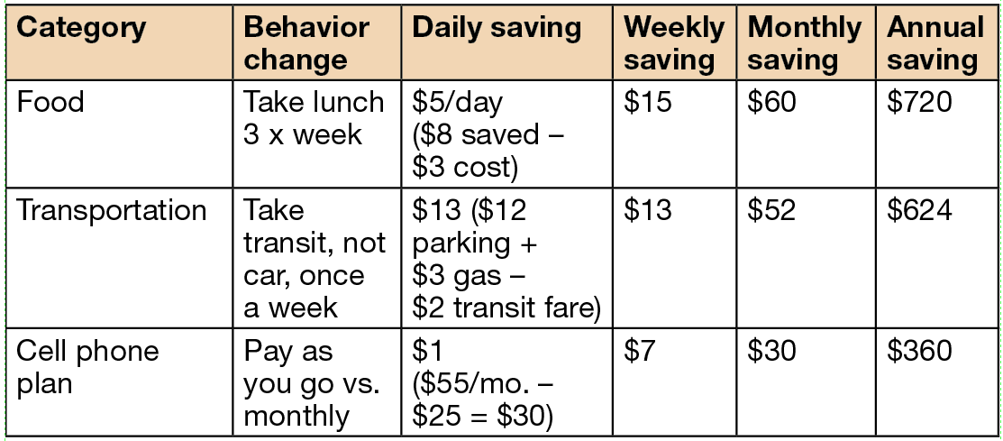
MANAGING YOUR COST OF LIVING – BE A SMART CONSUMER
How to cut $100/month of spending
30

Slide 32
MANAGING YOUR COST OF LIVING – NEEDS AND WANTS

Slide 33
MANAGING YOUR COST OF LIVING – NEEDS AND WANTS
What is your latte factor?
“We’ve all got a latte factor, regardless of our income level.” – David Bach
Designer coffees
Lunch in restaurants
Impulse buys
The latest, greatest [fill in the blank]
32

Slide 34
MANAGING YOUR COST OF LIVING – NEEDS AND WANTS
Questions to ask yourself
When does a want become a need?
What motivates you to buy – advertising, friends, trendy styles?
Does the urge to buy die the next day?
Do your purchases make you happier?
What “needs” are now collecting dust?
What can you learn to live without?
33

Slide 35
MANAGING YOUR COST OF LIVING – NEEDS AND WANTS
Reduce impulse buying
Avoid trips to stores and shopping malls and online buying sites.
Pay cash or cheque for purchases and only carry the cash you are wiling to spend.
Reduce available credit on your credit card and line of credit.
Leave credit cards at home.
Sleep on it and see if you still want it the next day.
Take baby steps and cut costs by increments.
34

Slide 36
CREDIT AND MANAGEMENT

Slide 37
CREDIT AND MANAGEMENT
36
Paying your credit card bill just a couple of days after the due date won't affect your credit report.
True or false?

Slide 38
CREDIT AND MANAGEMENT
37
All credit cards have the same grace period (also known as an interest-free period).
True or false?

Slide 39
CREDIT AND MANAGEMENT
38
Last month, your credit card balance was zero. This month, your statement shows that you made a $500 purchase. If you pay off $400 by the due date, you will be charged interest only on the $100 left to pay.
True or false?

Slide 40
CREDIT AND MANAGEMENT
39
If you use your credit card to take money out as a “cash advance”, you don’t have to pay interest on the amount you’ve withdrawn as long as you pay your credit card bill in full by the due date on your statement.
True or false?

Slide 41
CREDIT AND MANAGEMENT
Without a good credit history…
Your bank may charge you higher interest rates on a personal loan for a car, house, etc.
Your bank may refuse to give you a loan.
You might not be able to get a lease on an apartment.
A and B only.
All of the above.
40

Slide 42
CREDIT AND MANAGEMENT
How to stay out of trouble
Pay the balance in full each month.
If you can’t pay it in full, pay as much as you can.
Don’t make only the minimum payment.
If you always carry a balance, get a low-rate card.
Transfer the balance to a line of credit with a lower rate.
Pay a few days before the due date.
41

Slide 43
CREDIT AND MANAGEMENT
Minimum vs. fixed payments
Initial balance: $3,000
Interest rate: 18%
42

Slide 44
CREDIT AND MANAGEMENT
Tips for managing debt
Shop around.
Compare interest rates. Don’t accept your first offer.
Keep within your budget.
Borrow only what you can afford to pay back regularly and on time.
Pay back more and pay more often.
Additional payments mean you’ll pay it off sooner and pay less interest.
43

Slide 45
CREDIT AND MANAGEMENT
Canada Student Loans Program
For students in financial needs
Interest-free while you are enrolled in post-secondary education
Become payable 6 months after you leave your studies
Apply for this federal support through your provincial or territorial student assistance office
For more information, visit www.CanLearn.ca
44

Slide 46
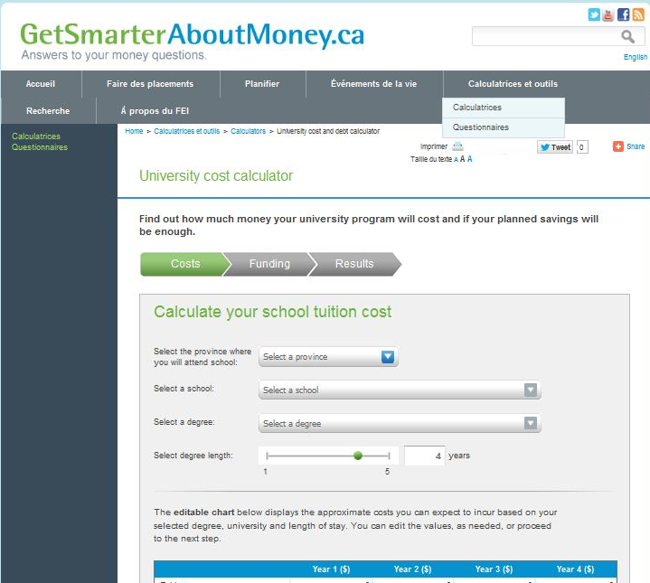
CREDIT AND MANAGEMENT
Student Debt Calculator
45

Slide 47
CREDIT AND MANAGEMENT
Getting a copy of your credit report is:
a) A good way to check for identity theft
b) The only way to know if your report is accurate
c) Free of charge, if you request the report be sent to you by mail
d) All of the above
46

Slide 48
CREDIT AND MANAGEMENT
If you have applied for several credit cards or other forms of credit within a short period of time, this could have a negative impact on your credit score.
True or false?
47

Slide 49
CREDIT AND MANAGEMENT
Which of the following does not affect your credit score?
48
a) Your payment history – whether you have ever missed a debt payment
b) Any collection of bankruptcy that has been recorded against you
c) Your history of repaying informal loans from family or friends
d) Any outstanding debts you have
e) Your account history – how long you have had credit, and the type of credit you have

Slide 50
CREDIT AND MANAGEMENT
Recognize the danger signals
You use your credit cards as a necessity instead of a convenience.
You use credit or cash advances for your daily living expenses.
You miss payments or due dates.
You’re near the credit limit on most of your cards.
You borrow from one card to pay another.
You transfer balances every few months just before the introductory offer expires.
49

Slide 51
CREDIT AND MANAGEMENT
Take control of your debt
Use savings to pay off balances.
Pay down your highest interest rate debts first.
Switch to less expensive credit cards.
Call creditors to negotiate lower rates.
Start automatic/online bill payment to stay on schedule.
Leave your credit card at home.
Avoid “buy now, pay later” offers.
Get a consolidation loan to make one low-interest payment.
50

Slide 52
SAVING AND INVESTING

Slide 53
SAVING AND INVESTING
Why save for the future?
Feel more secure and in control.
Be prepared for emergencies.
Reduce stress and conflict.
Spend with less guilt or fear.
Afford major purchases.
Pay off debt and avoid new debt.
Retire comfortably.
52

Slide 54
SAVING AND INVESTING
Make your goals specific
Set a dollar amount and deadline.
Break your goal into smaller goals.
Write down your goal and post it where you can see it every day.
53

Slide 55
SAVING AND INVESTING
Savings
Set up an emergency fund.
Pay yourself first.
Make savings automatic.
Grow your savings.
54

Slide 56
SAVING AND INVESTING
Make your savings automatic
Set up direct debits from your bank account or paycheque.
Save 5% to 10% of your take-home pay.
If you earn $2,000 a month after tax:
Saving 5 percent = $100 a month = $1,200 a year.
Saving 10 percent = $200 a month = $2,400 a year.
Extra money (from gifts, tax refunds, etc.) or a raise? Save it.
55

Slide 57
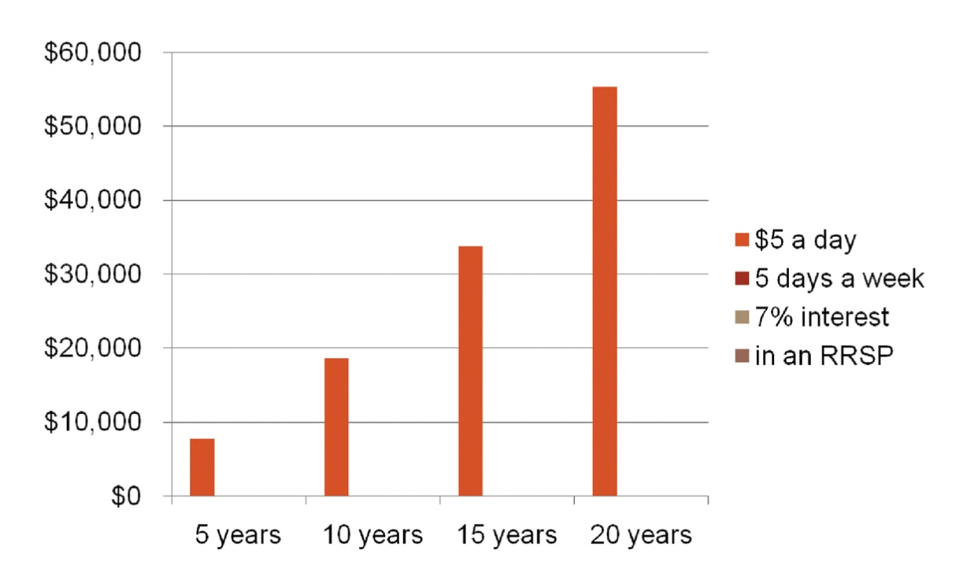
SAVING AND INVESTING
Compounding makes your money grow
56

Slide 58
SAVING AND INVESTING
57
Actions | Amy | Amanda
Starts saving at: | 20 | 30
Puts $1,000 a year into her RRSP to age: | 34 | 64
Total she saved: | $15,000 | $35,000

Slide 59
SAVING AND INVESTING
58
Actions | Amy | Amanda
Total she earns at age 65: | $141,700 | $116,100
Conclusion:
Start saving as soon as possible (the sooner the better)
Save as long as you can (for a long period of time)

Slide 60
SAVING AND INVESTING
Rule of 72: Time it takes to double your money
59
Interest rate | Your money doubles in:
2% | 36 years
4% | 18 years
6% | 12 years
8% | 9 years
10% | 7.2 years
12% | 6 years

Slide 61
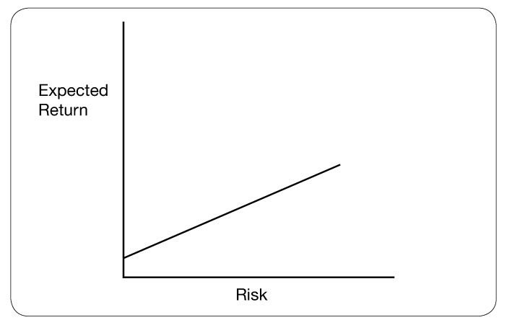
SAVING AND INVESTING
Risk and return
60

Slide 62
SAVING AND INVESTING
Four types of investments
Investments that pay interest (savings accounts, CSBs, GICs, etc.)
Shares in a company (stocks, mutual funds that invest in stocks, etc.)
Property (real estate, art, precious metals, etc.)
Direct investment in a business
61

Slide 63
SAVING AND INVESTING
Savings Account Selector Tool
62

Slide 64
SAVING AND INVESTING
Canada Savings Bonds
Available from early October to December each year.
Opt for regular or compound interest.
Buy online, where you bank or invest, or at your workplace through payroll deduction.
Canada Savings Bonds:
Cashable any time, but no interest paid if cashed within first 3 months.
Canada Premium Bonds:
Cashable only once a year but pay more.
63

Slide 65
SAVING AND INVESTING
GICs
Your money is locked up for a period of time, ranging from less than 1 month to 10 years.
Generally, the longer the term, the higher the rate of interest.
Traditional GICs: principal and return are guaranteed.
“Market-linked” GICs: principal is guaranteed, but returns are linked to a stock market index, so they fluctuate.
You can also get cashable GICs; more flexible but with lower rates.
64

Slide 66
SAVING AND INVESTING
Stocks
Shares in a company; you are partial owner of the company.
Share prices and returns can be positive or negative.
No guarantee of income: you could lose your whole investment.
Traded on stock exchanges or over-the-counter markets.
Stocks have outperformed other investment options by a wide margin over periods of 10 years or more.
65

Slide 67
SAVING AND INVESTING
Why invest in mutual funds?
Professional management
Diversification: your money is spread over several investments
Ease of access: you can generally sell any time
Readily available through most financial institutions
66

Slide 68
SAVING AND INVESTING
Questions to ask a prospective financial advisor
What is your background, experience and track record?
Is your firm registered with a securities commission or other formal body?
What can you do for me? Provide advice only, sell products, help me build a financial plan?
What products do you sell?
How do you get paid?
How do you work with your clients?
Can you provide references?
67

Slide 69
SAVING AND INVESTING
The three knows
Know yourself: your investment goals and timeline, your risk tolerance.
Know your investment: is it right for you?
Know your advisor.
68

Slide 70
SAVING AND INVESTING
Registered tax plans
Tax-Free Savings Accounts (TFSAs): earn income from investments without paying taxes on the income
Registered Retirement Savings Plans (RRSPs): defer paying income tax until retirement
Registered Education Savings Plans (RESPs): shift the tax to a student
Registered Disability Savings Plans (RDSPs): shift the tax to someone with a disability
69

Slide 71
FINANCIAL PLANNING

Slide 72
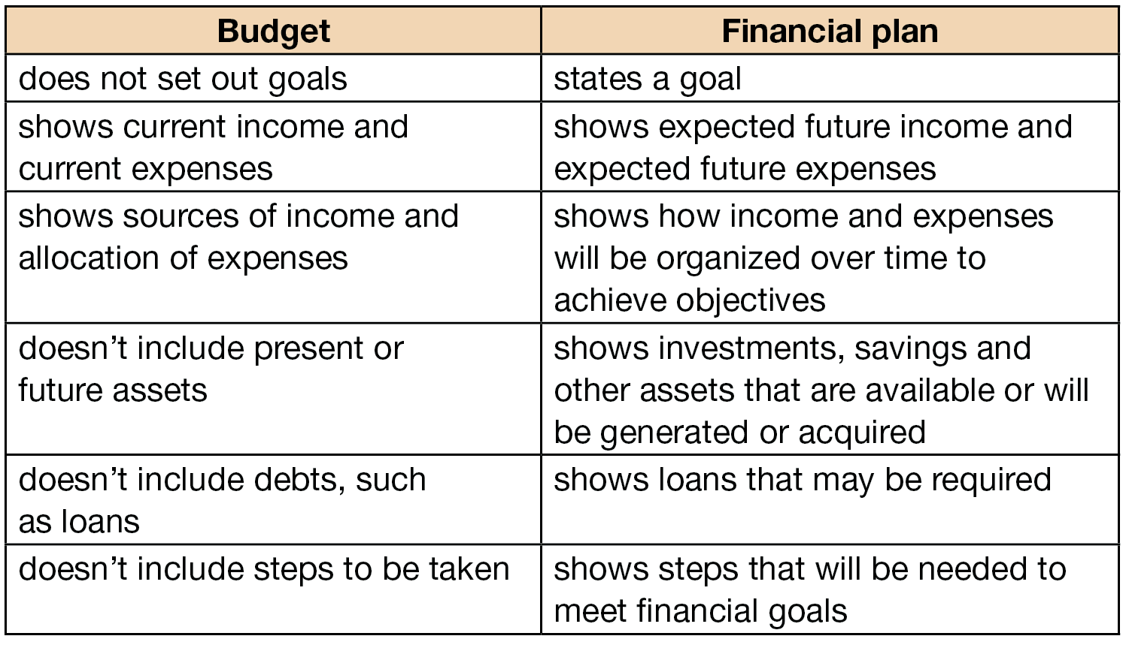
FINANCIAL PLANNING
Budget and financial plan
71

Slide 73
FINANCIAL PLANNING
How can a financial plan help you?
Minimize your taxes.
Cover insurance needs.
Buy a home and pay off the mortgage quickly.
Fund your children’s education.
Optimize employee benefits and pensions.
Save and plan for retirement.
Fund long-term health issues.
Care for elderly parents.
Manage estate planning and how to transfer wealth in families.
72

Slide 74
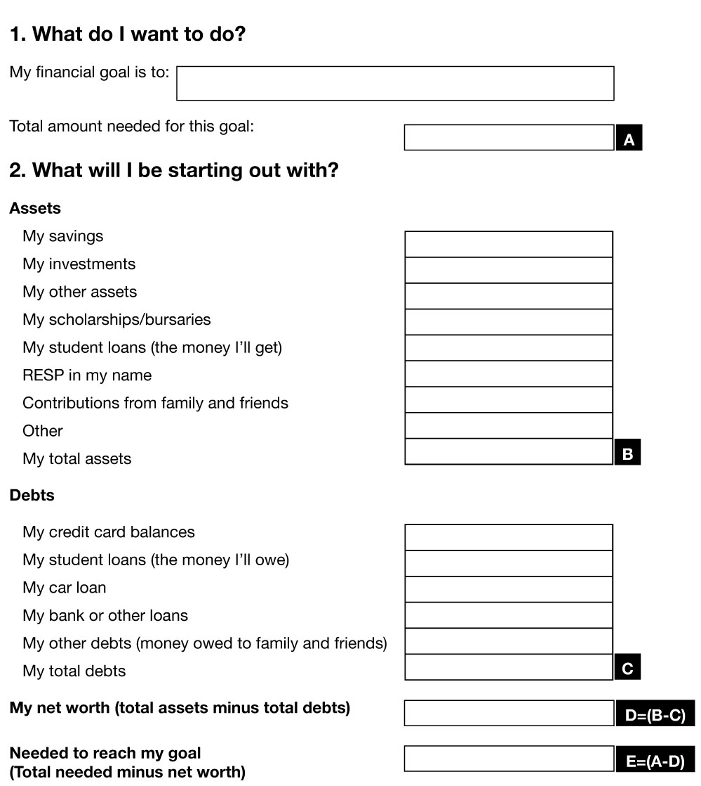
FINANCIAL PLANNING
73

Slide 75
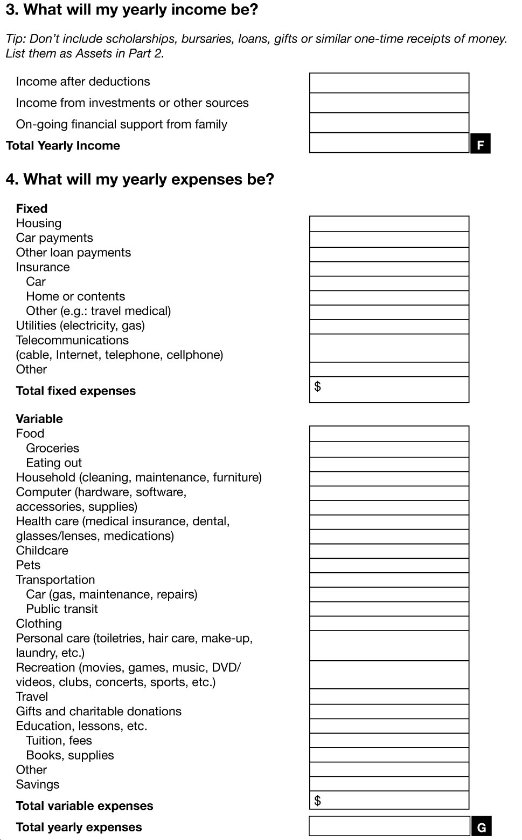
FINANCIAL PLANNING
74

Slide 76
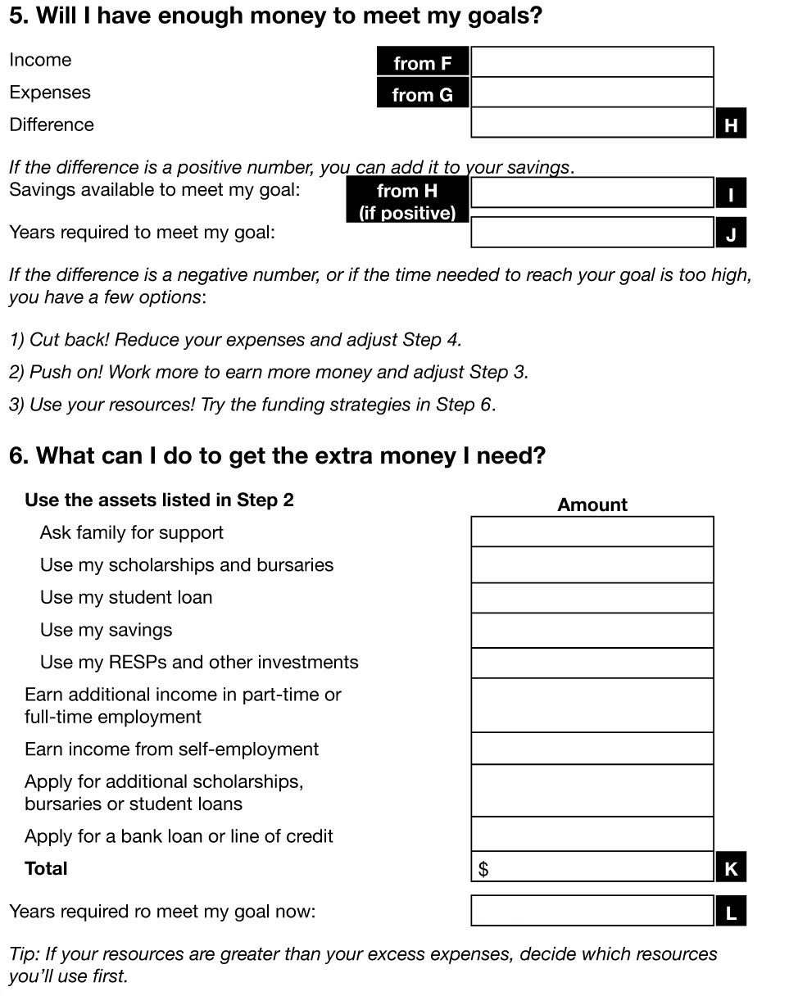
FINANCIAL PLANNING
75

Slide 77
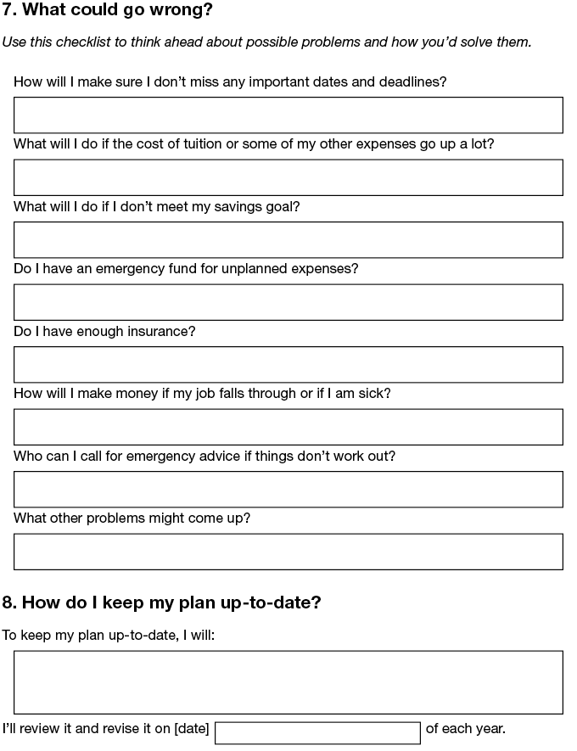
FINANCIAL PLANNING
76

Slide 78
PROTECT YOURSELF

Slide 79
PROTECTING YOURSELF
Identity theft statistics
In 2006:
4 million North Americans fell victim to identity fraud
Average loss to identity fraud: $1,086
Average loss per phishing attack : $1,244
Scholarship and loan scams: more than $100 million
Average loss from a scholarship or loan scam: $263
78

Slide 80
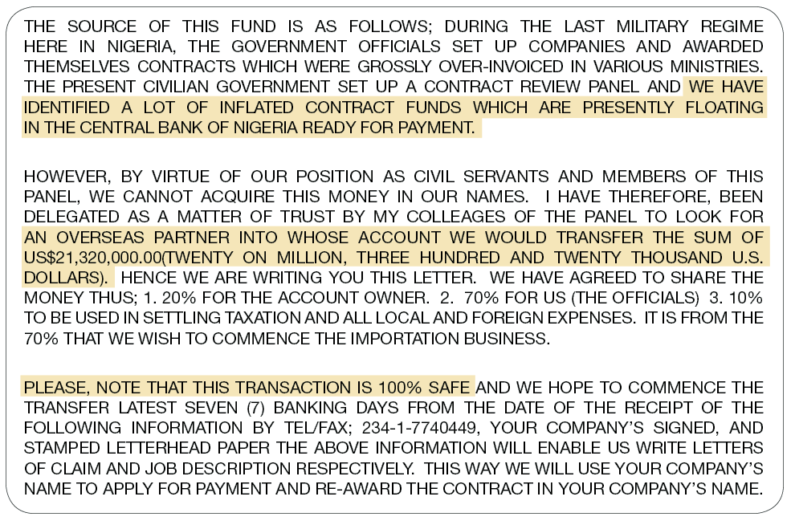
PROTECTING YOURSELF
Transfer of fund scam
79

Slide 81
PROTECTING YOURSELF
Lottery
scams
80

Slide 82
PROTECTING YOURSELF
Phishing emails and phony Web pages
81

Slide 83
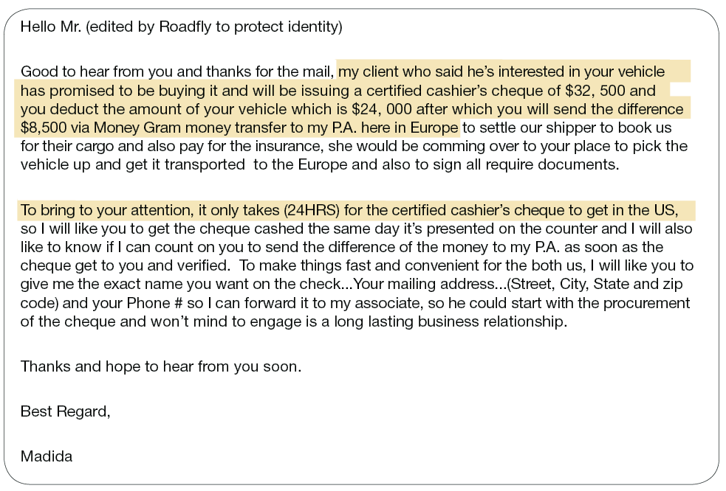
PROTECTING YOURSELF
Items for sale over-payment scam
82

Slide 84
PROTECTING YOURSELF
Signs of bogus job ads
Offer considerable pay with few to no duties
Promise payment of wages in cash
Contain no physical address or contact person
Require you to open a new bank account or accept company cheques to “test” a wire transfer service
83

Slide 85
PROTECTING YOURSELF
Protect yourself
Don’t share personal information freely.
Destroy documents with personal information.
Keep your wallet or purse safe.
Don’t carry ID you don’t need (such as SIN).
Lock your household mailbox if possible.
84

Slide 86
PROTECTING YOURSELF
Protect yourself, cont.
Limit the number of credit cards you hold.
Check your credit report once a year.
Make sure websites are secure before transmitting personal information.
Delete emails that ask for personal information.
Keep computer firewalls and spyware up-to-date.
85

Slide 87
PROTECTING YOURSELF
Keep your computer passwords safe.
Don’t give telemarketers personal information.
Destroy old documents that contain identity information.
Be skeptical – if an offer sounds too good to be true, it is!
Save paper bank records for at least a year.
Protect yourself, cont.
86

Slide 88
PROTECTING YOURSELF
What to do
Contact your financial institution immediately.
Notify Canada’s credit bureaus (Equifax Canada at www.equifax.ca and TransUnion Canada at www.transunion.ca).
Contact the Canadian Anti-Fraud Centre
Notify your local police as soon as you are aware of it.
87

Slide 89
SUMMARY AND WRAP-UP

Slide 90
SUMMARY AND WRAP-UP
Keep track of your income and your expenses in a budget.
Save money by questioning your bills and reducing your “latte factor.”
Pay yourself first with automatic savings.
Start an emergency fund.
Shop around for the best banking accounts, credit cards and service plans.
Pay all debts on time and in full, if possible.
Set clear savings goals.
Find a licensed financial advisor for long-term investment guidance.
Use RRSPs and TFSAs to let your savings grow tax-free.
Secure your identity and avoid identity theft.
What have we learned?
89

Slide 91
SUMMARY AND WRAP-UP
FEEDBACK
90
Please complete the participant evaluation form that is included with your participant handbook

